Slide 1
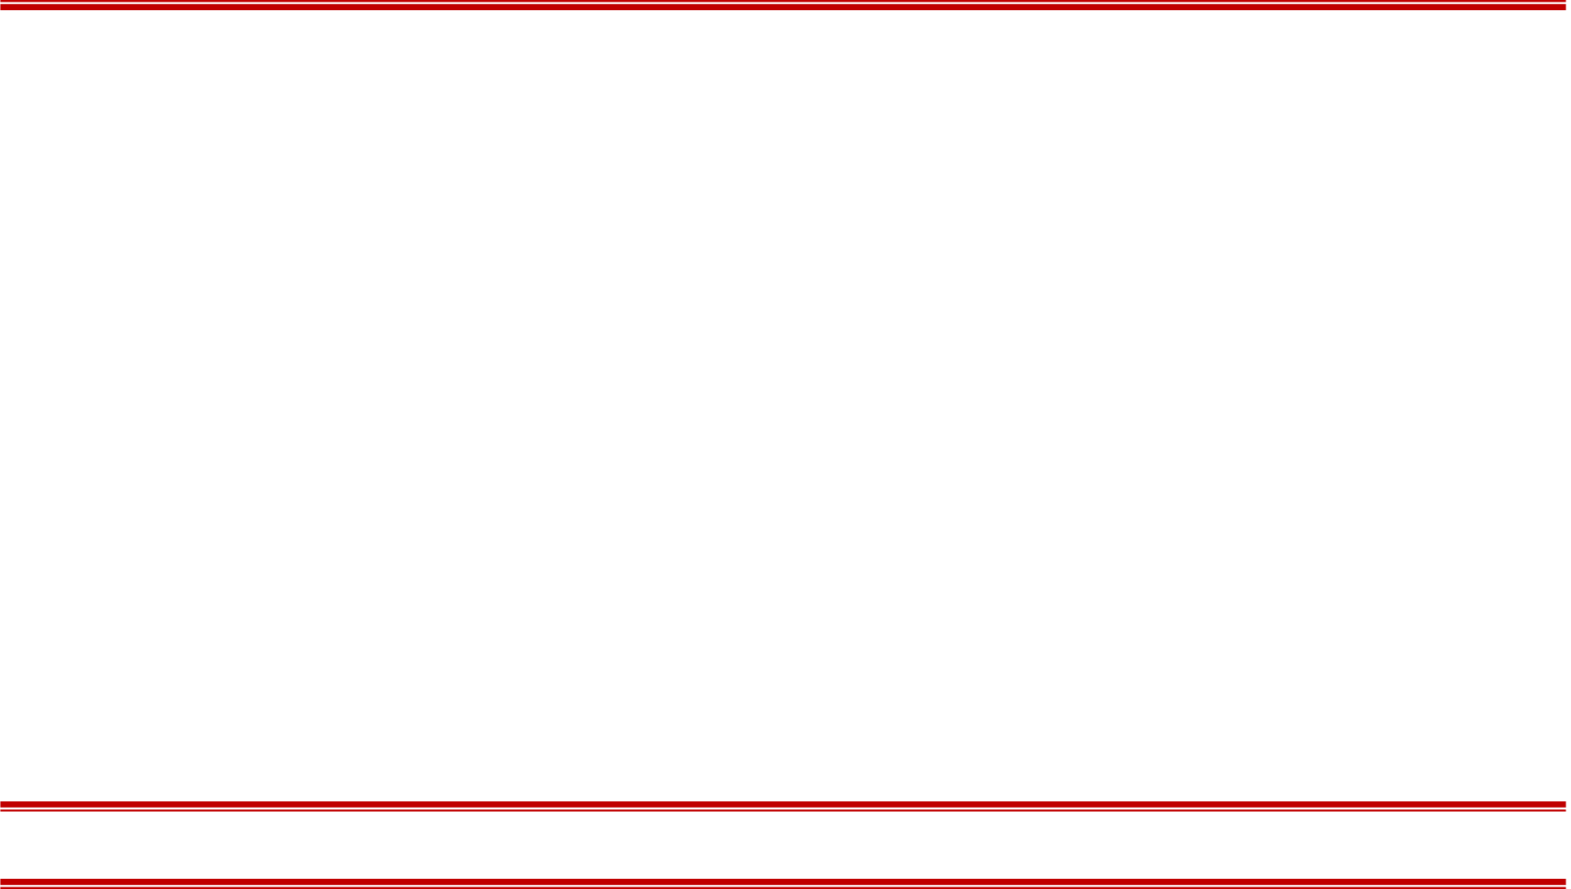
Part 1 Project Overview

Slide 2
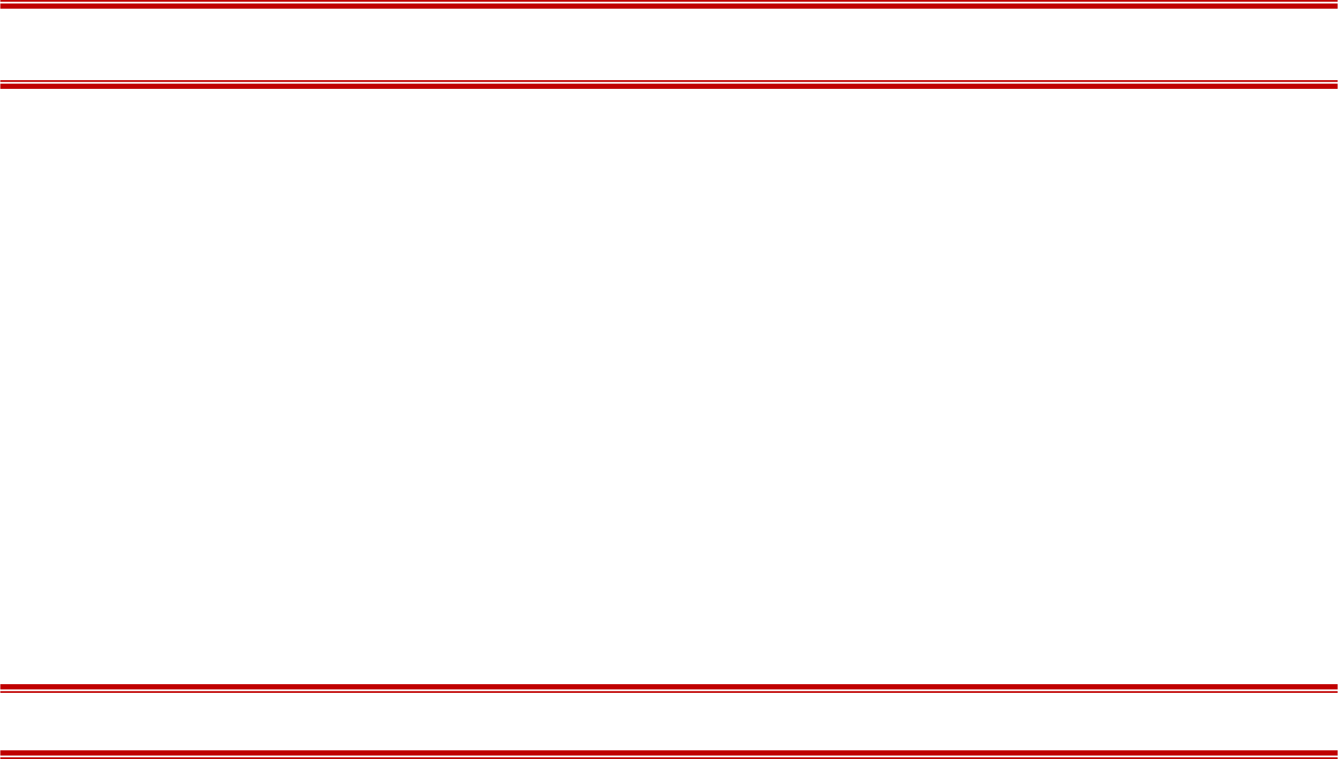
Goals
探究光吸收/光衰减、光飞行时间（ToF）两类测量模态在脑组织中的传播规律
将SSC技术（Short Separation Channel）用于FD-fNIRS，结合光吸收、光飞行时间两类测量模态实现脑功能信号与非功能信号的分离

Slide 3
Basic Equations
Boltzmann Transport Equation（BTE，用于描述光在组织中的传播）：
Boundary Condition (Type III) of BTE：
Categories of fNIRS：
CW-fNIRS (Continuous Wave)：
FD-fNIRS (Frequency Domain)：
TD-fNIRS (Time Domain)：

Slide 4
References
[1] Doulgerakis M, Eggebrecht A T, Dehghani H. High-density functional diffuse optical tomography based on frequency-domain measurements improves image quality and spatial resolution[J]. Neurophotonics, 2019, 6(3): 035007.
[2] Wheelock M D, Culver J P, Eggebrecht A T. High-density diffuse optical tomography for imaging human brain function[J]. Review of Scientific Instruments, 2019, 90(5): 051101.
[3] Brigadoi S, Cooper R J. How short is short? Optimum source–detector distance for short-separation channels in functional near-infrared spectroscopy[J]. Neurophotonics, 2015, 2(2): 025005.
[4] Gagnon L, Cooper R J, Yücel M A, et al. Short separation channel location impacts the performance of short channel regression in NIRS[J]. Neuroimage, 2012, 59(3): 2518-2528.
[5] Dehghani H, Eames M E, Yalavarthy P K, et al. Near infrared optical tomography using NIRFAST: Algorithm for numerical model and image reconstruction[J]. Communications in numerical methods in engineering, 2009, 25(6): 711-732.

Slide 5
Part 2 Reserch Diary

Slide 6
Section 1
Basic Operation of the NIRFAST Toolbox (I) —— Forward Problem

Slide 7
References
[1] Dehghani H, Eames M E, Yalavarthy P K, et al. Near infrared optical tomography using NIRFAST: Algorithm for numerical model and image reconstruction[J]. Communications in numerical methods in engineering, 2009, 25(6): 711-732.
[2] https://milab.host.dartmouth.edu/nirfast/tutorials/Head%20Model%20Tutorial.pdf
[3] https://milab.host.dartmouth.edu/nirfast/tutorials/NIRFAST-Intro.pdf

Slide 8
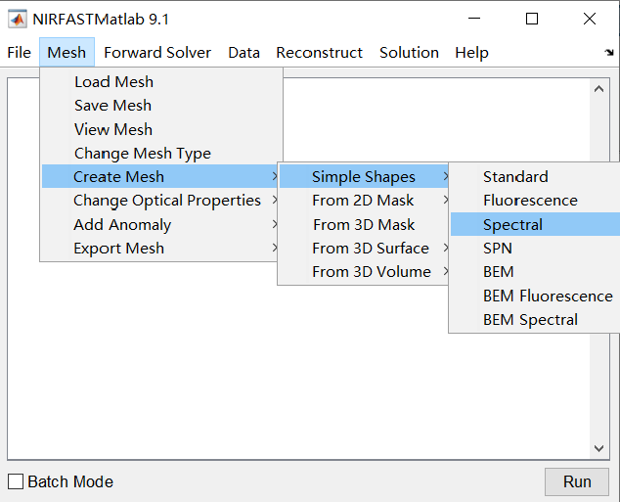
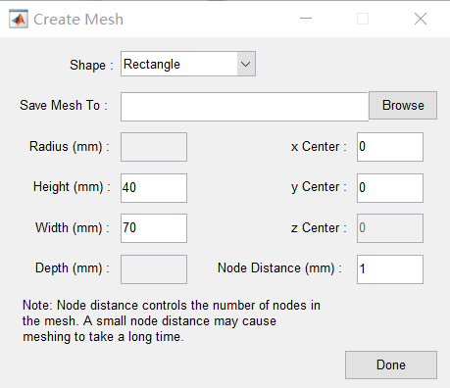
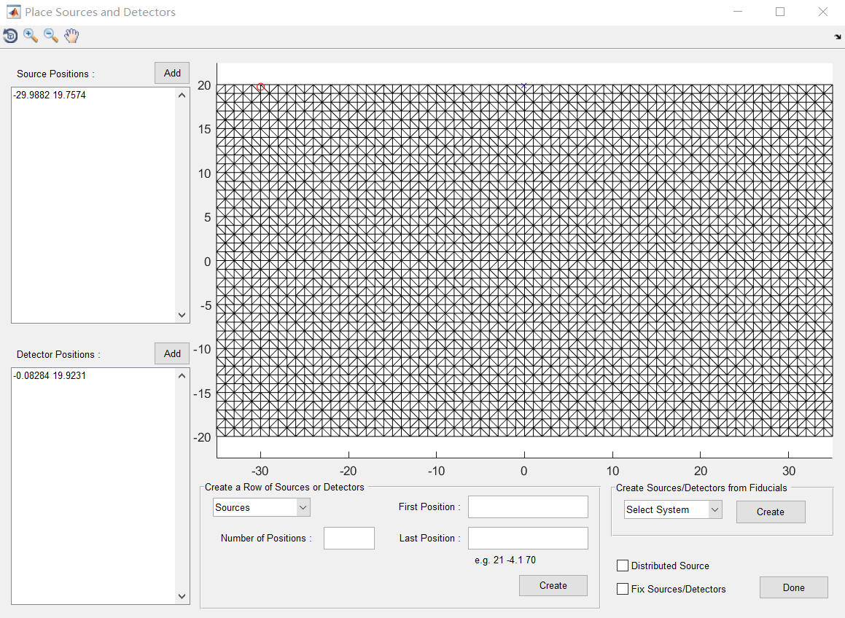
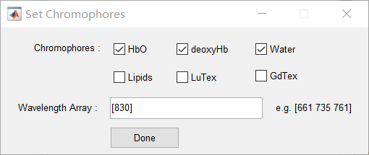
Creating the Mesh
③ Locate the sources and detectors
Way 1：Define the mesh by yourself (typing nirfast to open the NIRFAST GUI)
① Choose the mesh type
② Set parameters
④ Set chromophores

Slide 9
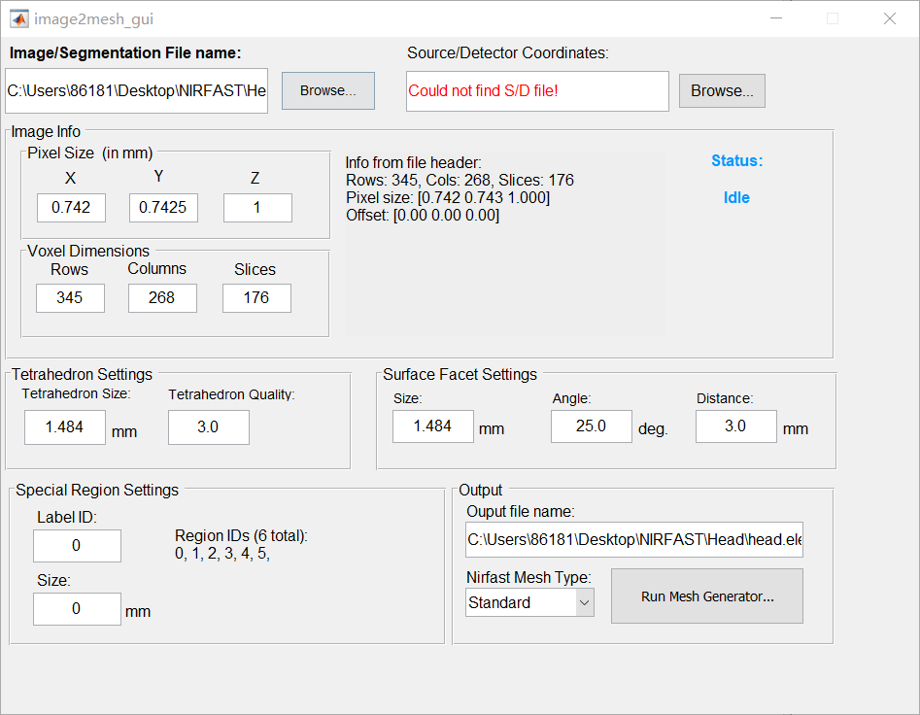
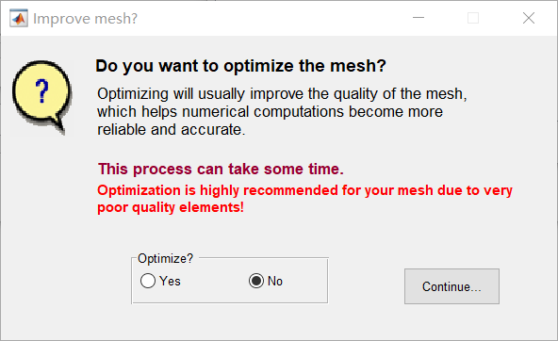
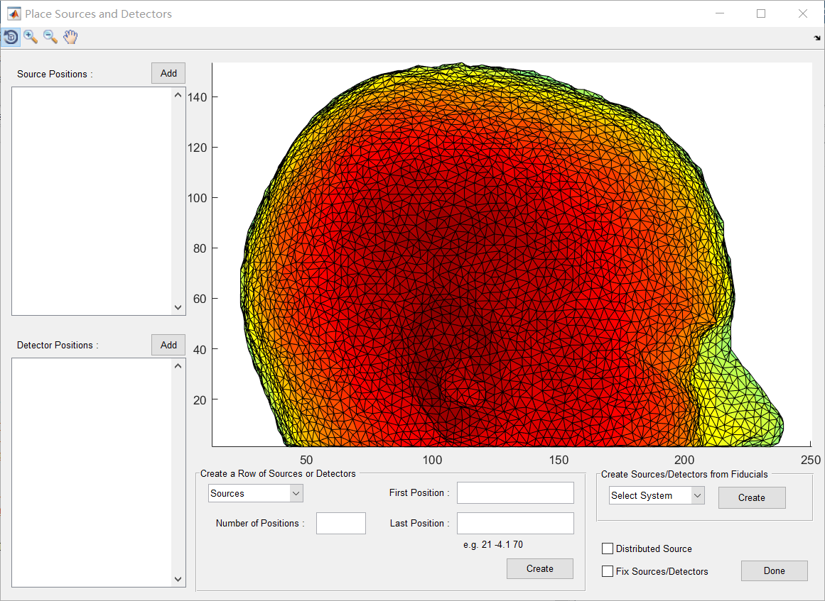
Creating the Mesh
Way 2：Construct the mesh by using .mha file (typing image2mesh_gui to open the Image2Mesh GUI)
① Load the .mha file and set parameters
② Improve the Mesh (No)
③ Locate the sources and detectors
④ Set chromophores
After creating the mesh, using save_mesh to save the mesh file

Slide 10
Mesh File Analysis
When you generate a mesh (model), you are creating 8 files：
.node：the coordinates of the mesh nodes (with x, y, z coordinates)
.source：the coordinates of the sources
.meas： the coordinates of the detectors
.link：the linking of each source and detector (Default：All sources are connected with all detectors)
.elem：the element connectivity
.param：the optical properties of the mesh nodes
.region：region label of each node
.excoef：the extinction coeff for parameters at each wavelength

Slide 11
Section 2
Calculation Method of the Sensitivity Matrix

Slide 12
References
[1] Dehghani H, Eames M E, Yalavarthy P K, et al. Near infrared optical tomography using NIRFAST: Algorithm for numerical model and image reconstruction[J]. Communications in numerical methods in engineering, 2009, 25(6): 711-732.
[2] Doulgerakis M, Eggebrecht A T, Dehghani H. High-density functional diffuse optical tomography based on frequency-domain measurements improves image quality and spatial resolution[J]. Neurophotonics, 2019, 6(3): 035007.

Slide 13
Basic Structure of the Jacobian

Slide 14
Basic Structure of the Jacobian
the change in log of amplitude/phase of the mth measurement arising from a small change in κ at the nth node
the change in log of amplitude/phase of the mth measurement arising from a small change in μ_{a} at the nth node

Slide 15
How to Caculate?
Transfer the parameters：
The molar absorption spectra of the tissue’s absorbing chromophores
The chromophore concentrations
Scatter Power
Scatter Amplitude

Slide 16
How to Caculate?
Caculate the new Jacobian：
Kronecker Product
All calculations are done at a specific wavelength, for the multi-wavelength：

Slide 17
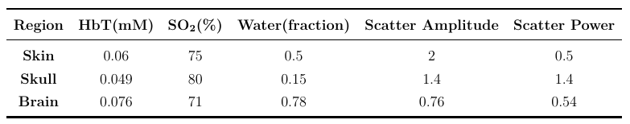
An Example
Basic settings：
1 source and 1 detector, FD-fNIRS
A three-layered model (skin-5mm, skull-8mm, brain-27mm)
2D mesh
Single wavelength of 830nm
Modulation frequency of 140MHz
The optical properties in different regions：

Slide 18
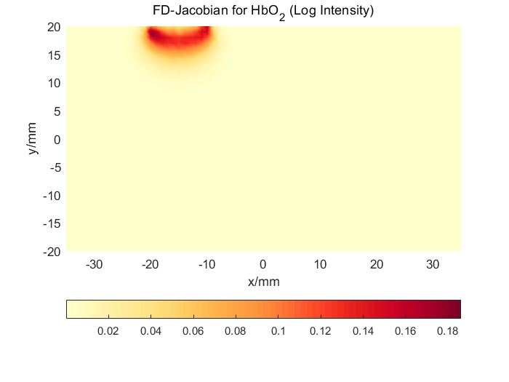
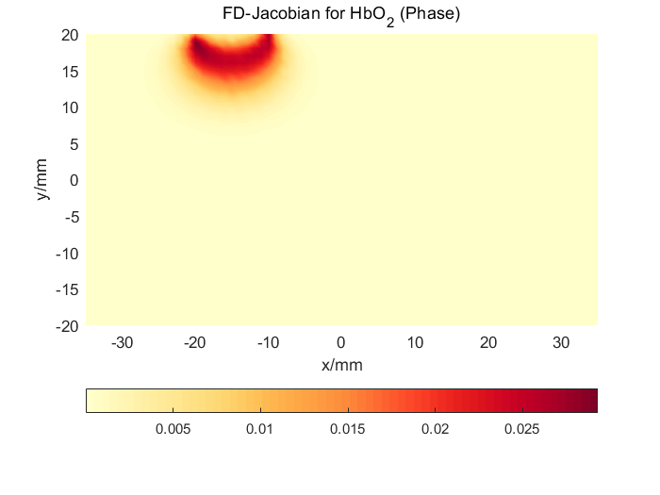
An Example
Results：
10mm (source to detector)

Slide 19
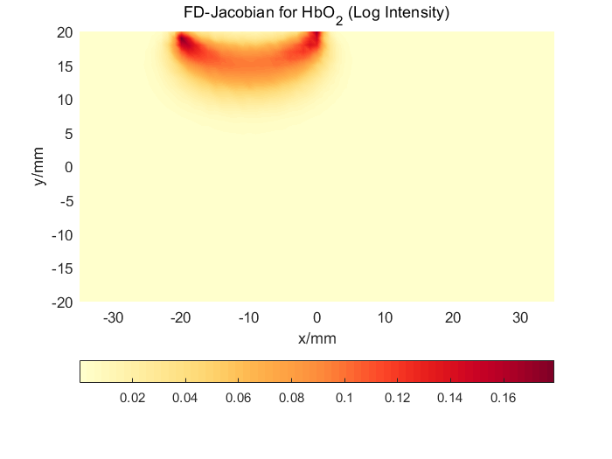
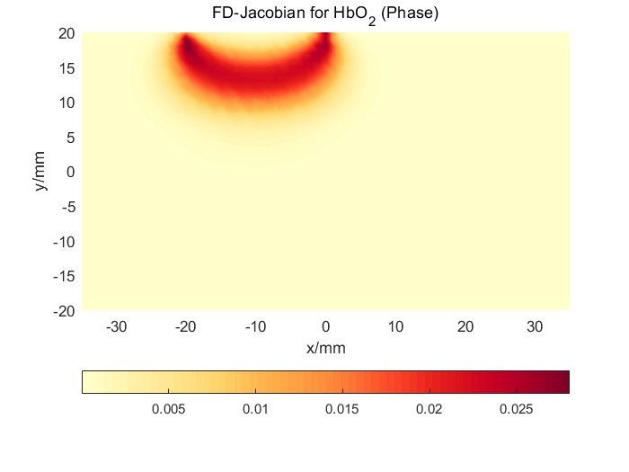
An Example
Results：
20mm (source to detector)

Slide 20
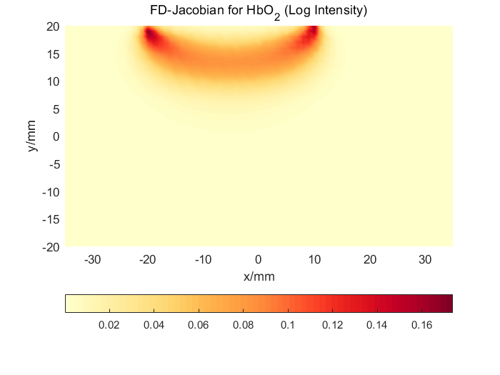
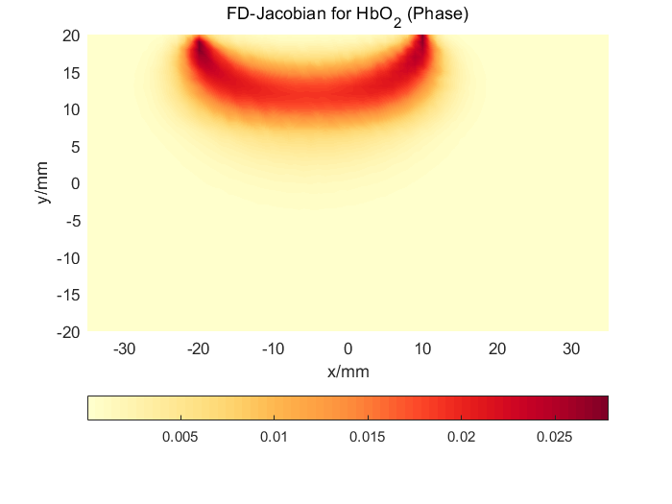
An Example
Results：
30mm (source to detector)

Slide 21
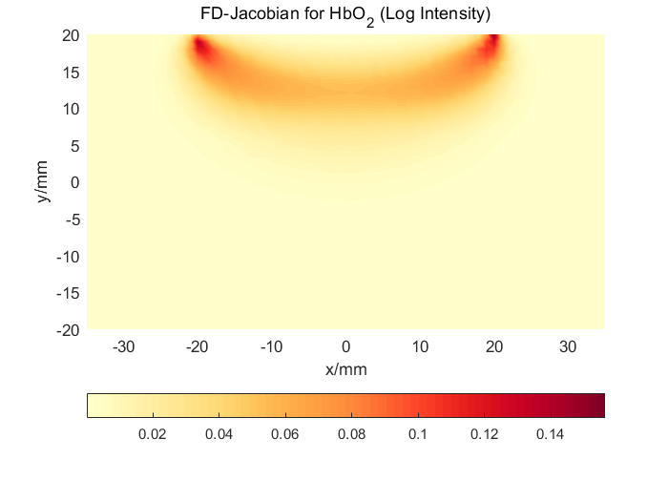
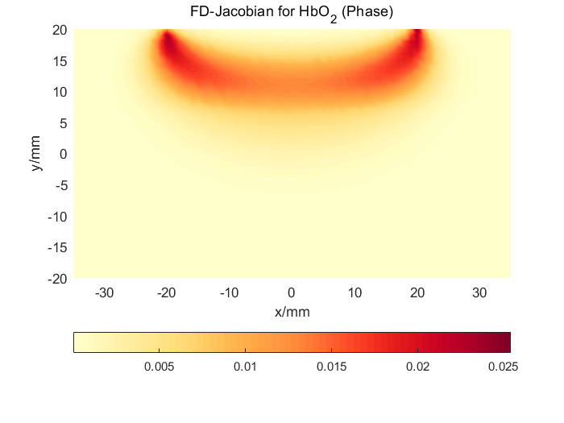
An Example
Results：
40mm (source to detector)

Slide 22
Part 3 Weekly Summary

Slide 23
Weekly Summary (2023/1/8-2023/1/18)
Read the paper of FD-fNIRS
Learn the basic operation of NIRFAST Toolbox
Try to generate a sensitivity matrix by using NIRFAST Toolbox (Base on [1])

Slide 24
Next Step
Read the paper of FD-fNIRS
Read the paper of SSC tech.
Read the source codes of NIRFAST Toolbox and try to fix some bugs

